Slide 1
City Microclimate and Traffic Analysis
Fyrogeni Ariadne 1083816
Psychogiou Georgia 1083979

Slide 2
Operations
Accurate microclimate forecasts and predictions.
Correlation between microclimate and traffic data.
Visualization of heatmaps and graphs.
Alerts and warning reports.

Slide 3
Requirements
Resources
Accurate microclimate data in specific locations
Numerous environmental sensors, sparsely located
Real-time data ingestion
MQTT, HTTP
Historical environmental and traffic data
Data Bases
High availability of collected data and system future scalability
FIWARE context broker
Notes:
Accurate microclimate data in specific locations in the city -> numerous environmental sensors, sparsely located
Real-time data ingestion from sensors and APIs (reliable & low latency communication) -> LoRa Wide Area Network
Historical environmental and traffic data (not available by APIs) for finding systematically observed deviations between regional weather data and microclimate data from sensors and correlation between circulation and microclimate -> save in Data Bases (InfluxDB, SQLite3)
High availability of collected data and system future scalability -> FIWARE [context broker: enables the integration of data from multiple systems and supports organizations to display and understand their data]

Slide 4

System Architecture
Connector
InfluxDB
Grafana
MQTT broker
Front-end (Website)
Context broker
Sensors
Request API
publish
subscribe
NGSI RESTful API
Data Processor
Back-end
http
Data Ingestion
Weather API
Update API
SQLite3
Traffic API
http
Visitors API
Sensors Data
Localized data
http
Weather API Data
Correlation
Traffic API
Notes:
Data Input:
Sensors publish real-time data to the MQTT broker.
Weather and traffic APIs fetch complementary data.
Data Processing:
Subscriber processes MQTT messages and stores them in InfluxDB.
Data from APIs are stored in InfluxDB as well.
Data Analysis:
API data is localized by comparing it with sensor data.
Perform statistical analysis (e.g., correlation) using Python.
Data Output:
Serve data to the web dashboard.
Visualize heatmaps and graphs.
Report warnings.

Slide 5
DATA PROCESSING
Connector
InfluxDB
Grafana
MQTT broker
Front-end (Website)
Context broker
Sensors
Request API
publish
subscribe
NGSI RESTful API
Data Processor
Back-end
http
Data Ingestion
Weather API
Update API
SQLite3
Traffic API
http
CLOUD
Visitors API
http
VIRTUAL GATEWAY
Notes:
Data Input:
Sensors publish real-time data to the MQTT broker.
Weather and traffic APIs fetch complementary data.
Data Processing:
Subscriber processes MQTT messages and stores them in InfluxDB.
Data from APIs are stored in InfluxDB as well.
Data Analysis:
API data is localized by comparing it with sensor data.
Perform statistical analysis (e.g., correlation) using Python.
Data Output:
Serve data to the web dashboard.
Visualize heatmaps and graphs.
Report warnings.

Slide 6
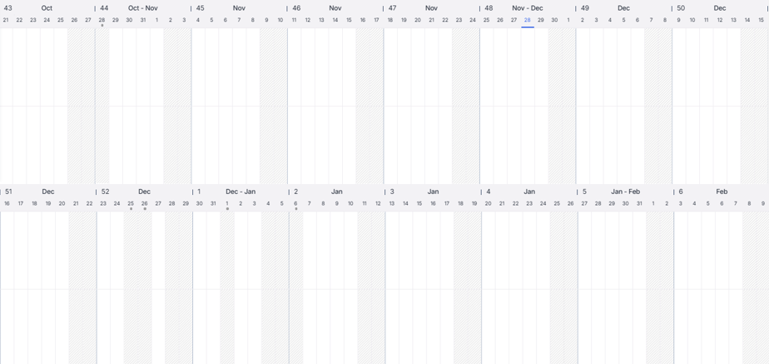
Work schedule
Configuration of the project idea
System Architecture study
Sensors and APIs’ data management
Virtual Gateway
Syntax of 1st presentation
Syntax of 2nd presentation
Virtual Gateway
Cloud
Website composition
Data processing

Slide 7



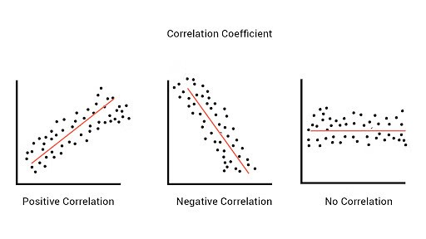





Technologies - Tools
Python
JavaScript
Pearson Correlation
Fiware
Grafana
GitHub
Figma
Open Weather Map
Tom Tom

Slide 8
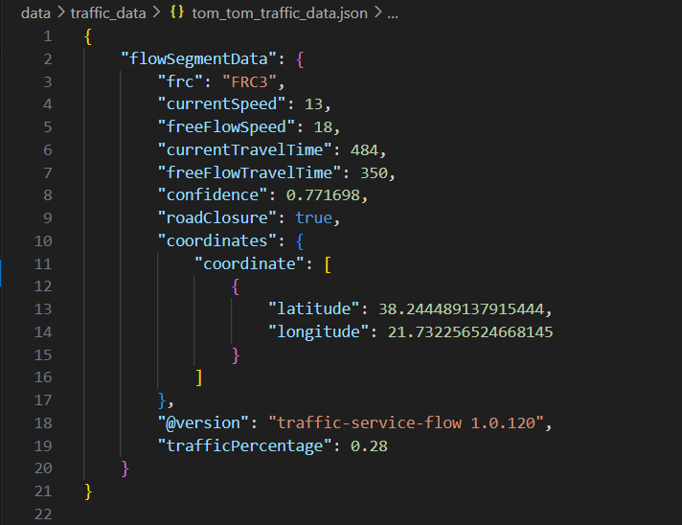

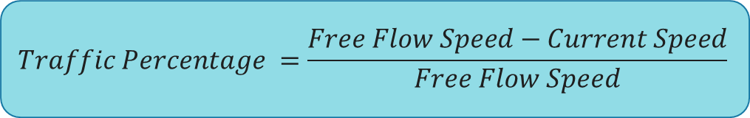
Tom-tom api
$$Traffic Percentage =\frac{Free Flow Speed−Current Speed}{Free Flow Speed}$$

Slide 9
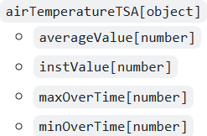


Smart data model
https://github.com/smart-data-models/dataModel.Weather/blob/master/WeatherObserved/doc/spec.md

Slide 10
Demo / Drafts

